Slide 1


PY-EXPO
2K24
Team ID:T092
Team Name: SYNTAX SNIPERS
Genius innovation leaves behind a legacy...
PYEXPO 2K24

Slide 2
PS Code: PY149
Problem Statement:
Identify duplicate bills in expense management system
02
PYEXPO 2K24

Slide 3
Solution
1.Standardize bill data by normalizing formats, such as dates, amounts, and vendor names.
2. Incorporate database checks to compare incoming bills against existing records.
3. Conduct checks on bill amounts to identify potential duplicates.
4. Create a review queue for administrators to manually inspect flagged duplicates.
5.Consolidating and Identifying duplicate bills and replacing it with single bill.
v
Technology Stack
Front-end : HTML ,CSS
Data-base : SQL, Django
Language used for development: Python
03
PYEXPO 2K24

Slide 4
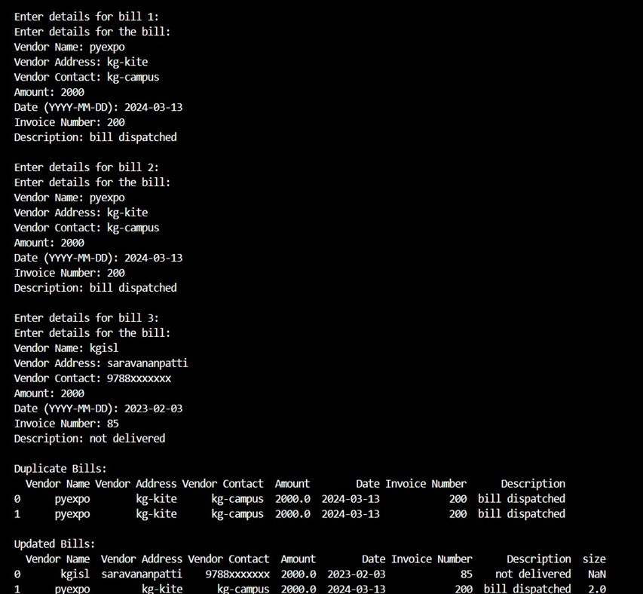
START
READ BILL DATA
INITIALIZE DATA STRUCTURES
-BILLS_LIST
-UNIQUE_BILLS_SET
LOOP THROUGH BILLS FOR EACH BILLS
EXTRACT BILL DETAILS
EG.(INVOICE NUMBER AND DATE)
CHECK FOR DUPLICATE BILLS
IF BILL IN UNIQUE_BILLS_SET, DUPLICATE FOUND
DUPLICATE FOUND (NO)
DUPLICATE FOUND (YES)
MARK DUPLICATE AND STORE DETAILS
CONTINUE LOOPING
END OF LOOP
PYEXPO 2K24
04
*OUTPUT*
END

Slide 5
Team Member Details:
Tanushri.Y - 23ECB51 BE. ECE
Sri Janani.S - 23ECB42 BE. ECE
Nehashri.V - 23ECB07 BE. ECE
Rathika.S - 23ECB18 BE. ECE
05
PYEXPO 2K24

Slide 6

Any Queries?
PYEXPO 2K24

